Slide 1
PatBaSe: A Pattern-based similarity search of anomalous curves in qPCR studies
Vijay B. Reddy, GTS Analytics Team and Sharada Vijaychander
Notes:
PatBaSS thought process started about a couple of months with Instigation by our team leader Sharada encouraging any innovative thinking within our data analytics team
To improve our analysis or with more brooder prospective.
The slide deck reviewing process we have bee carrying out, exposed to some of automated scripts that GTS analytics team has written for stastical analysis has helped us to know several aspects of qPCR amp curves and their usefulness for detection Flu A/B, Covid19 & RSV etc. Infectious deceases.
Comparison qPCR machines and how right Lod concentrations are determined and also about how various statistical evaluations are performed etc.

Slide 2
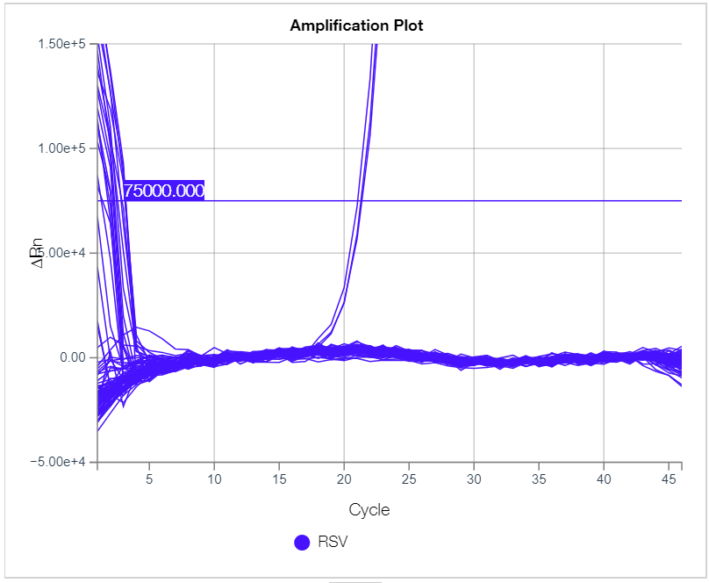
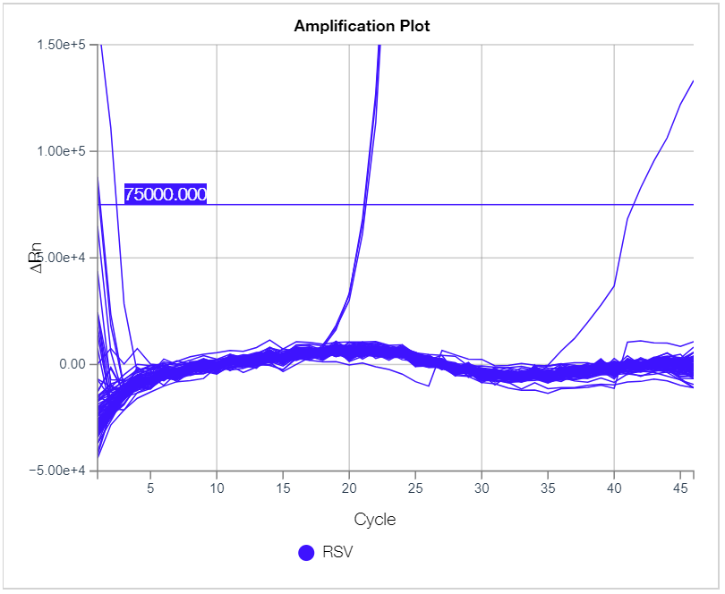
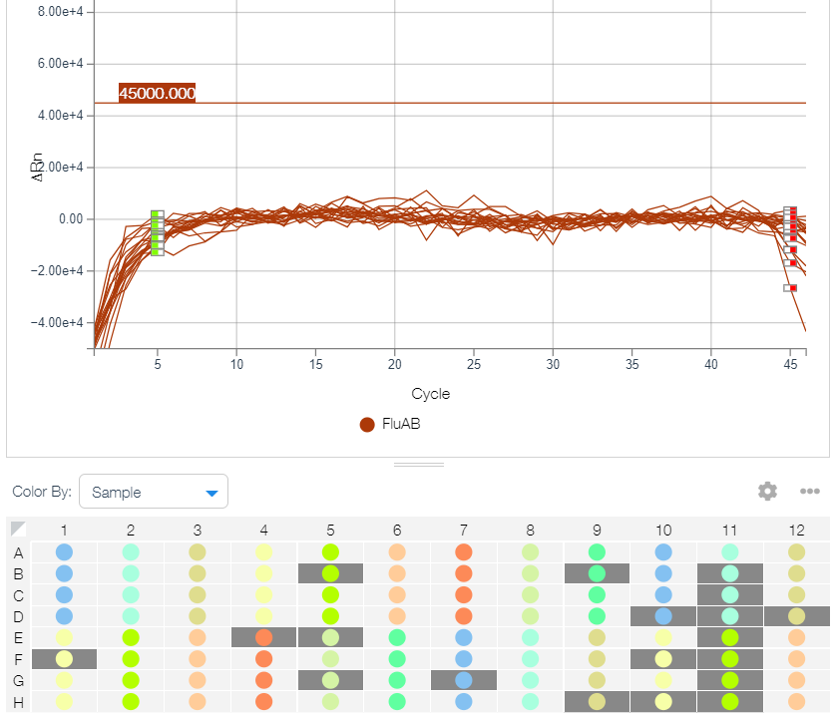
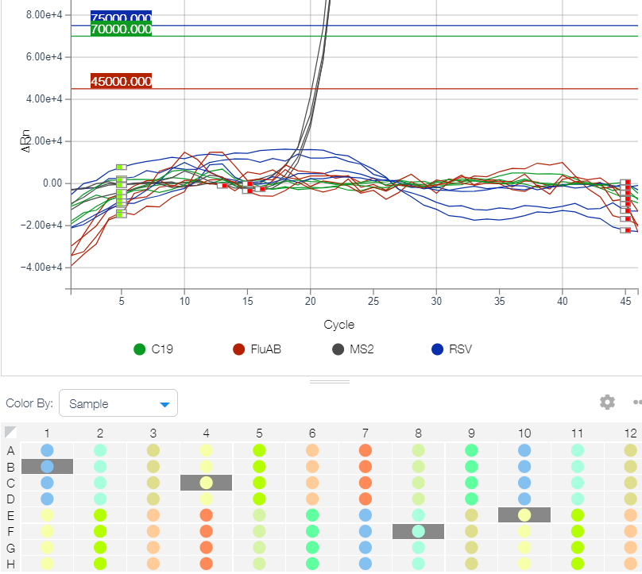
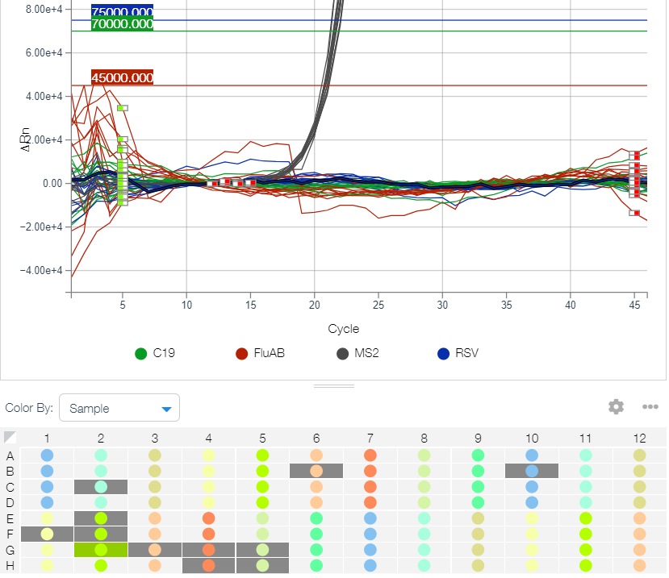
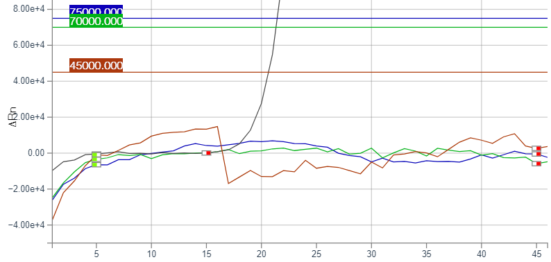
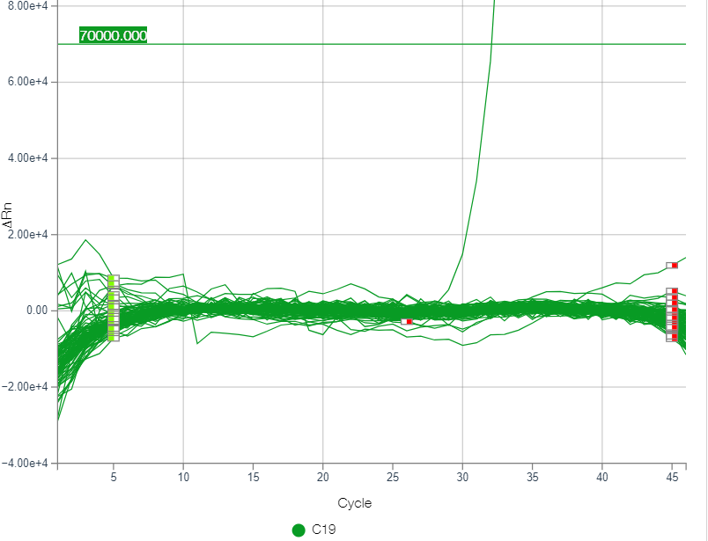
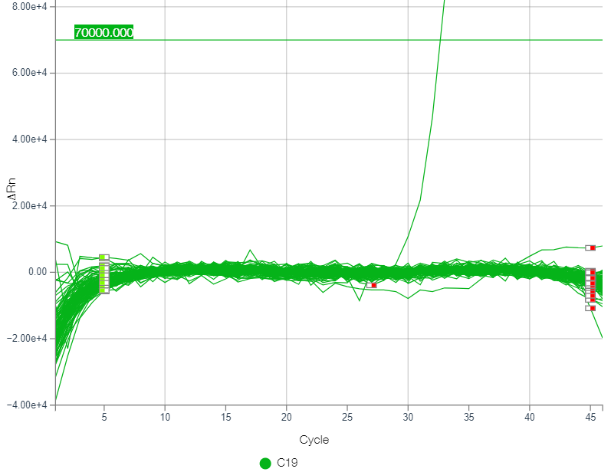
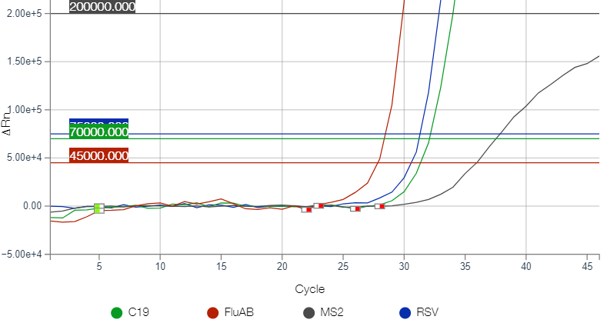
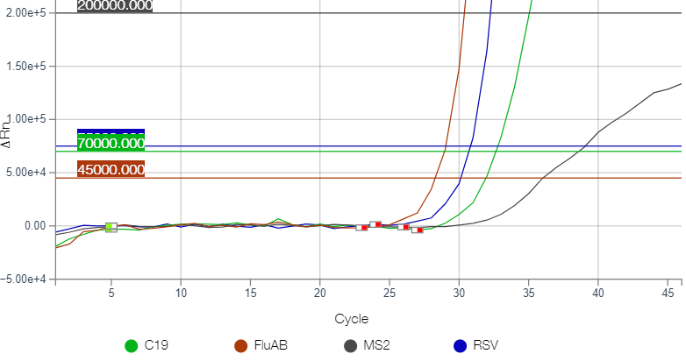
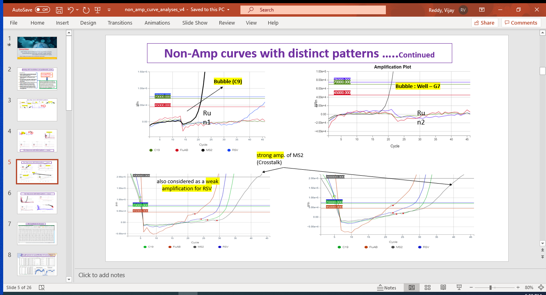
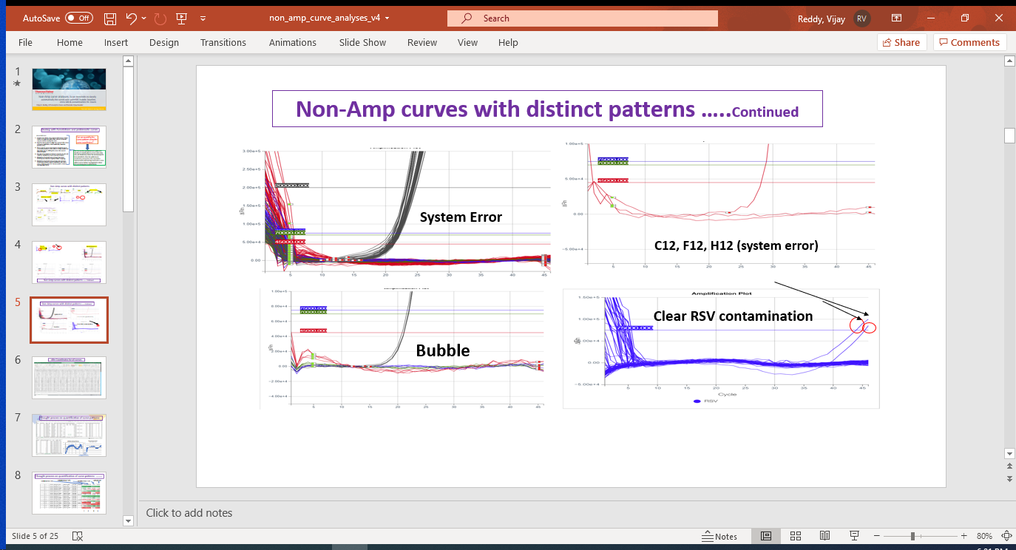
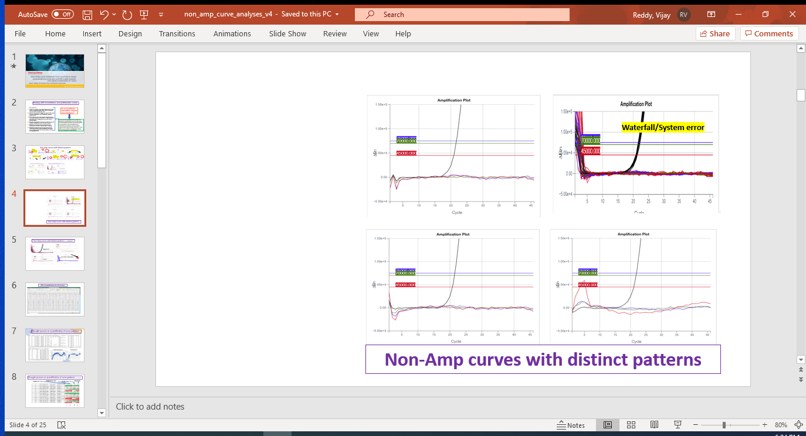
Non-Amp curves with distinct patterns
Clear RSV contamination at Well C1 C2 C3.
Bubble
Bubble
Weak C19 amp.
Baseline issue
Noisy Baseline
contamination at Well C1 C2 C3.
Weak amp. (Crosstalk)
Clear RSV contamination at Well C1 C2 C3.
Notes:
In the process of our report review I noticed several anomalous curves with appropriate names and explanations.
Sometimes we ourself involved in preparation of reports on our own using some of the automated scripts written by our offsite team in order to give a quick to R & D team.
As explained by experts the anomalous curves are labeled as clear, contaminated, bubble, weak Amp, baseline problem, water falls and revers water-falls, cross reactivity of dyes etc.
Presentations from experts have shown such problems.
Example of week Amps of different magnitude, base-line problem of several kind.

Slide 3
Problematic Amp/Non-Amp curves in qPCR How can we handle them?
Annotations:
Visual looks of the curve and sometimes its relative looks in comparison with other curves in the well may be used to classify the curve
Experts may be able to judge by a name to the curve (creepers, waterfalls, baseline problem etc.) may know the reason why a distortion happened.
There may be some reasoning by experts to say as cross talks, bubbles in the wells or contamination of dyes that may be drifting the curve into several variant shapes.
Rounds of annotations between experts also do not match to satisfactory levels and has been tested.
Reduction of variant curve-groups (Rule book versions) designed to help and to improve annotations.
Reduction of variant curve-groups may increase consensus between expert annotators but raises more confusion space for human and/or machine learning. Because in the reduction process, the curves of different patterns gets placed in common groups, learning the distinct features of a group will be problematic.
Can we quantify the curve pattern using the curve coordinates?
One can use the quantified curve pattern to identify all related patterns across entire data sets, will drastically reduce the human-experts time and efforts. Once the patterns are classified by measurable scale it can be used for comparison purpose. Improvements and learning aspects for a curve pattern can be further investigated to obtain very promising gains in the qPCR world.
Notes:
A summary of how these annotated curves are evaluated. – Read clearly the written matter.
Can we quantify the curve patterns??
Usefulness of quantification. – Read clearly the written matter.

Slide 4
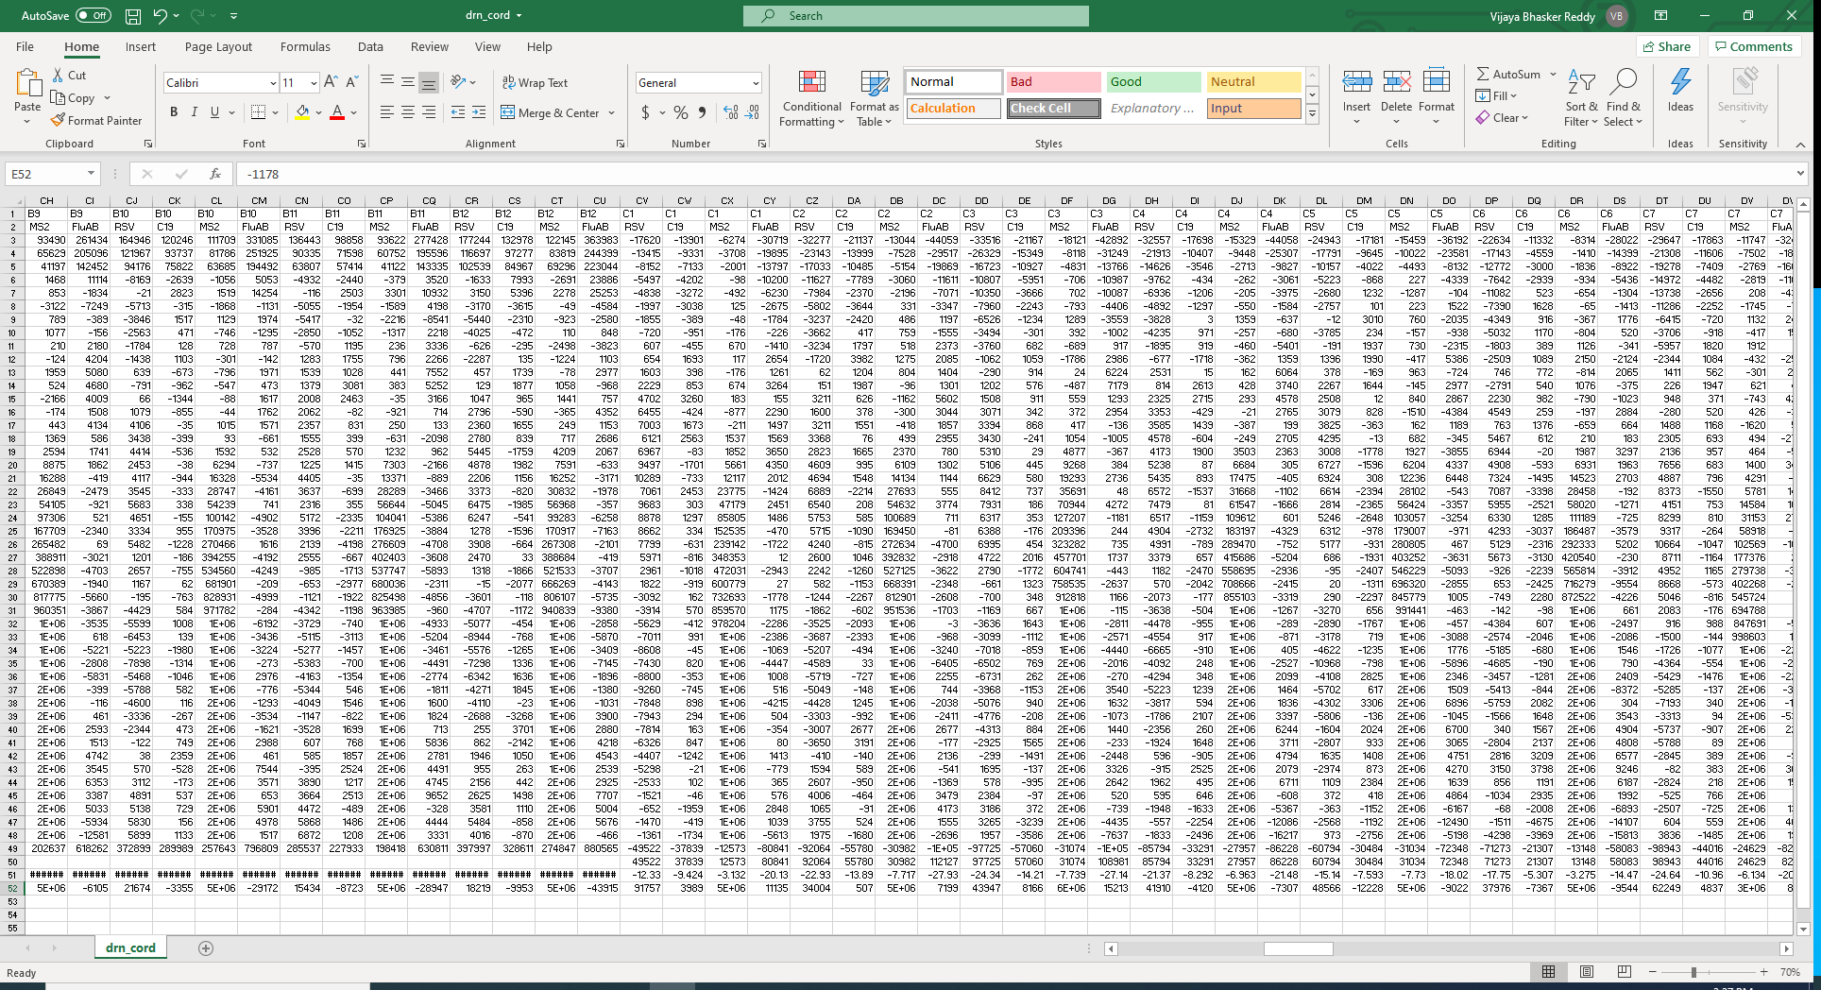
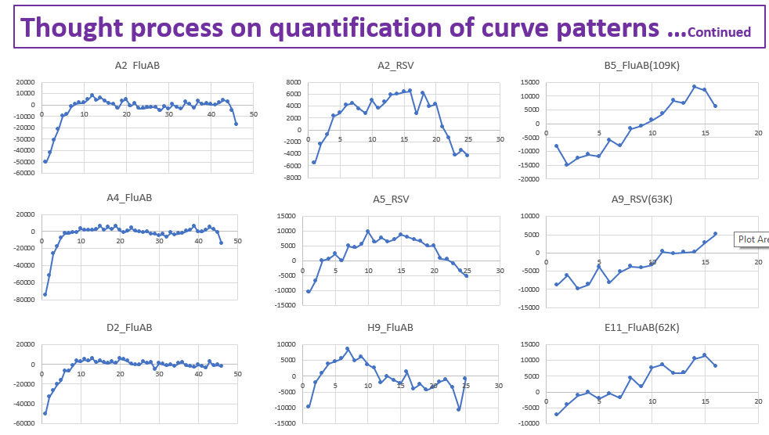
Thought process on quantification of curve patterns
Amp Data +
Results Sheets
1-5
1-46
1-46
A
B
B+C
C
SUM of Distances from X-Axis
Notes:
When we export DA2 analysis result into excel sheets we se dRn co-ordinates of the curves.
Use of the 3D-coordinates in my past life when worked on protein structural data (PDB)
Can we use this information for curve pattern quantification?
Started working on Amp data excel sheet.

Slide 5
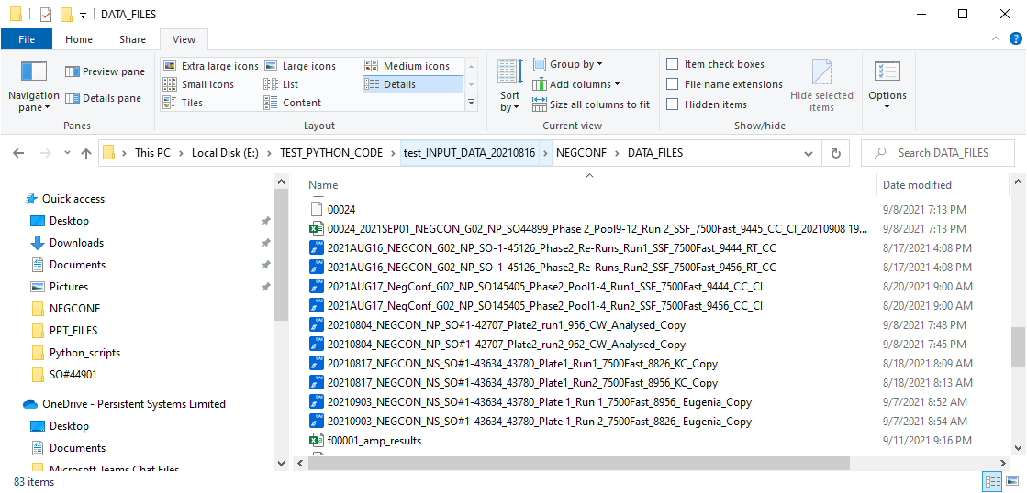
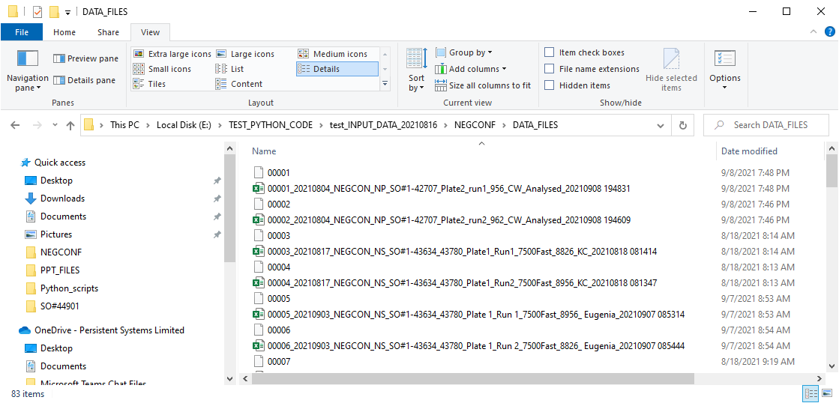
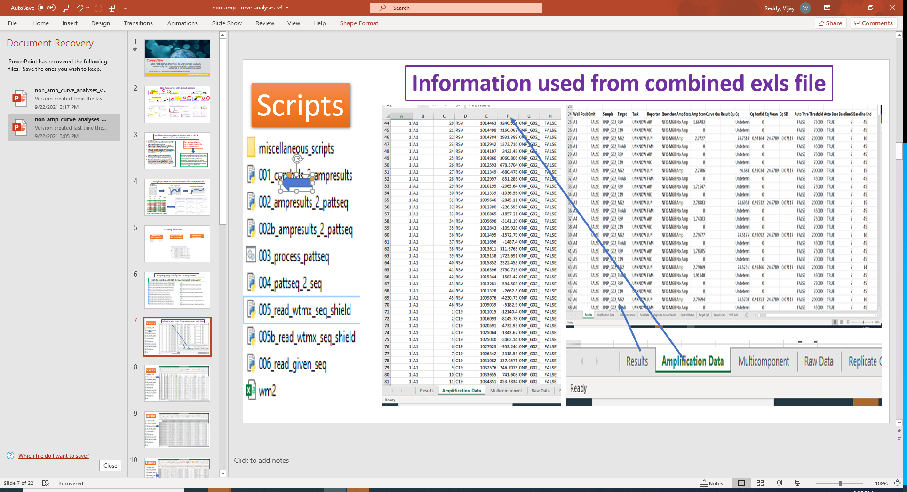
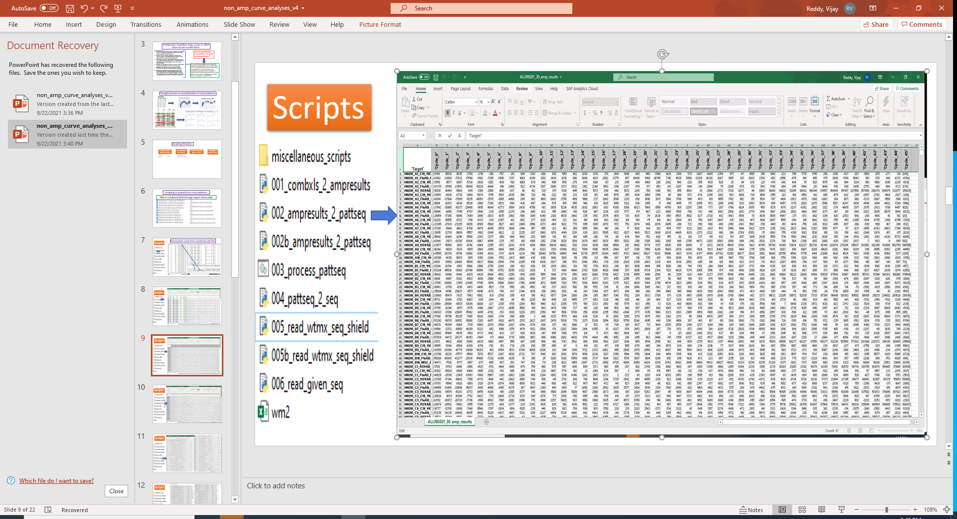
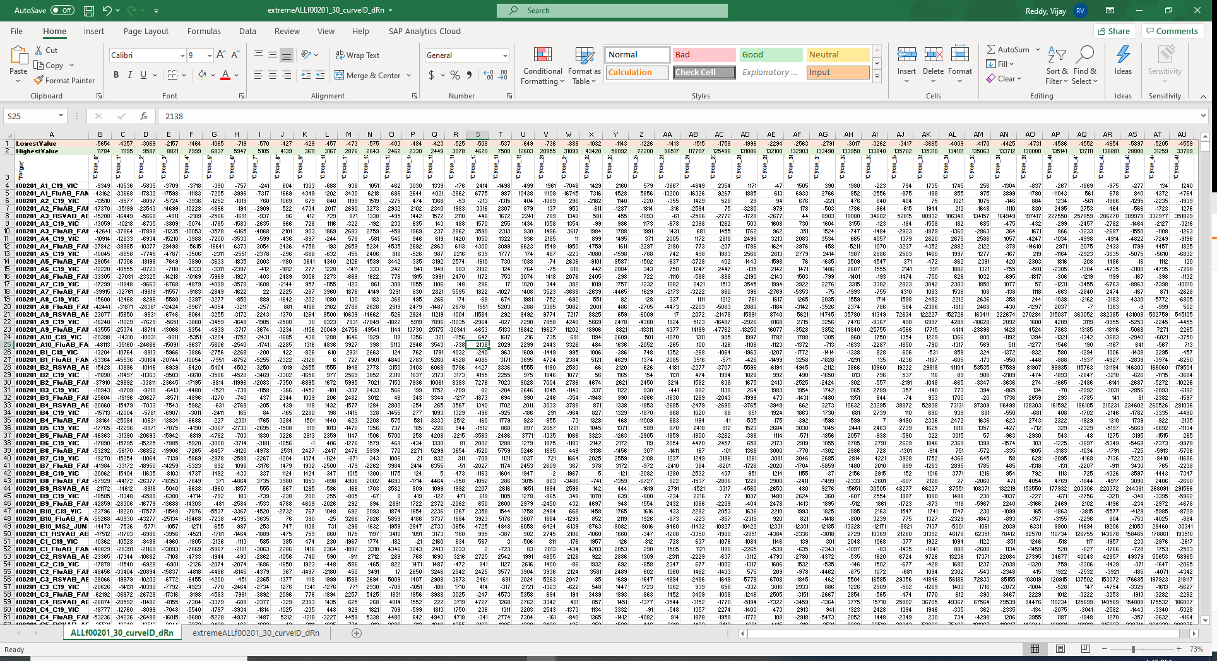
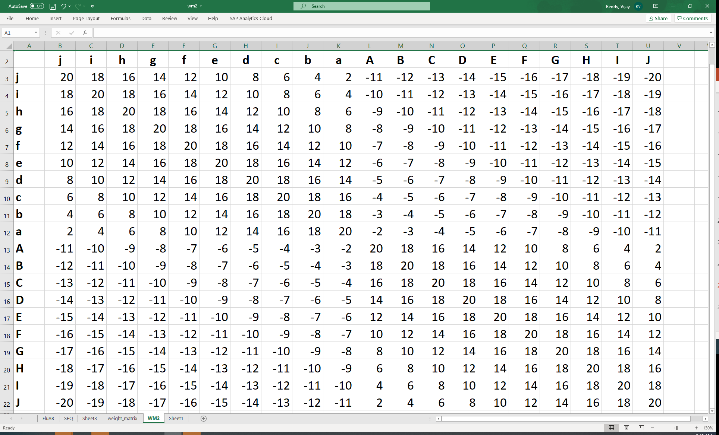
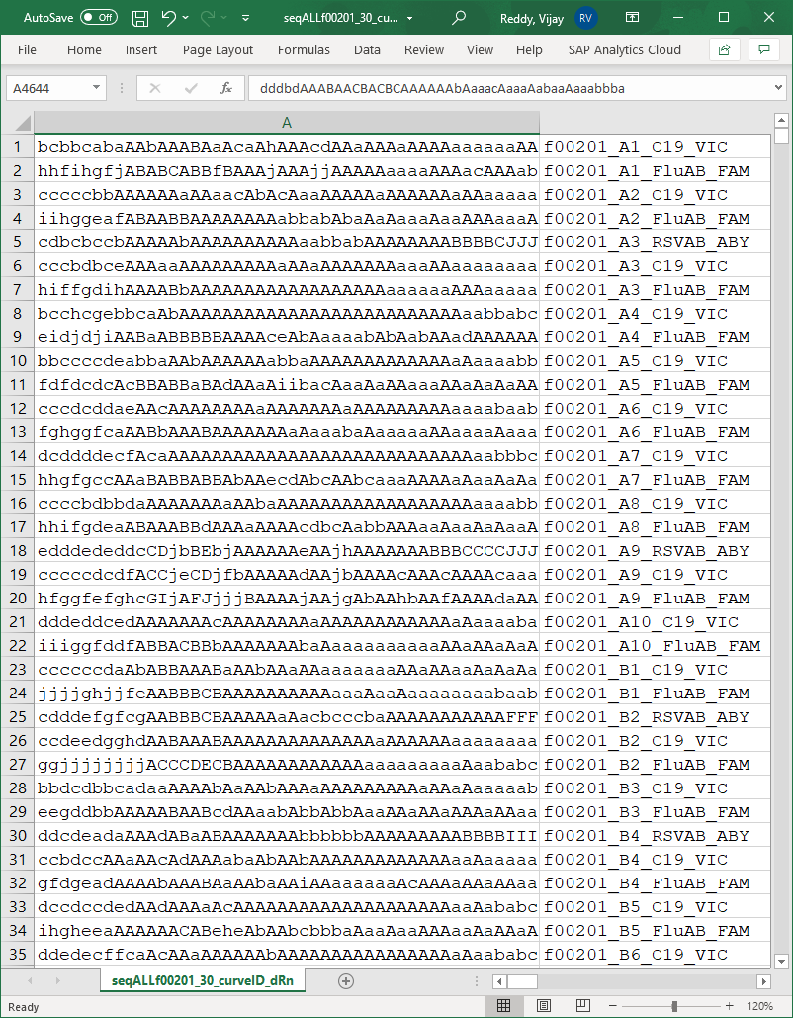
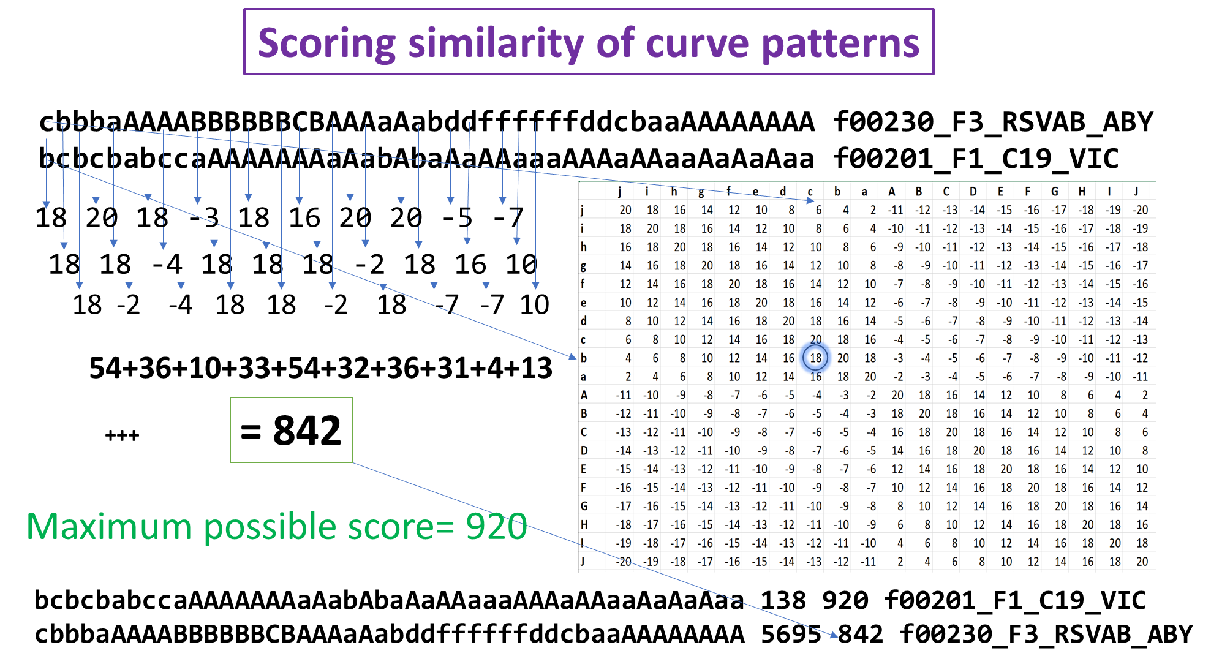
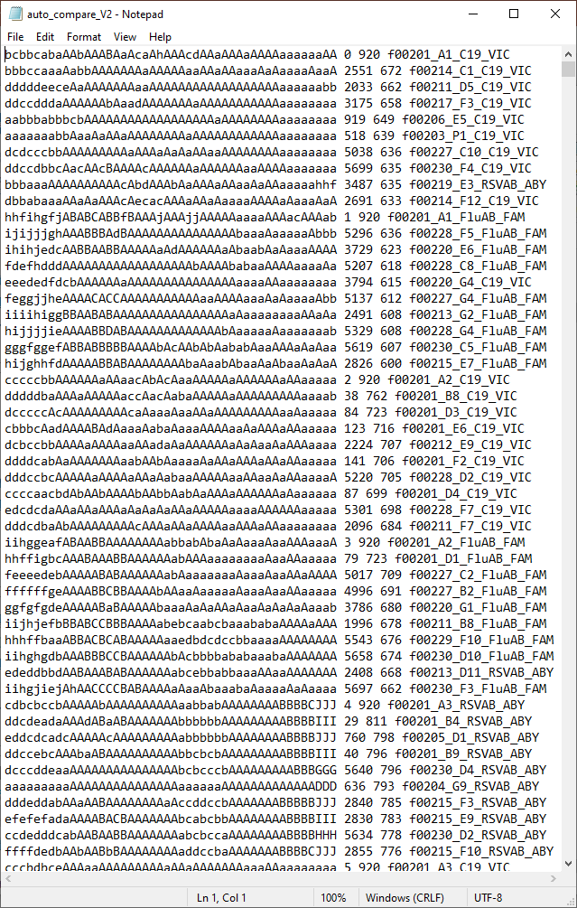
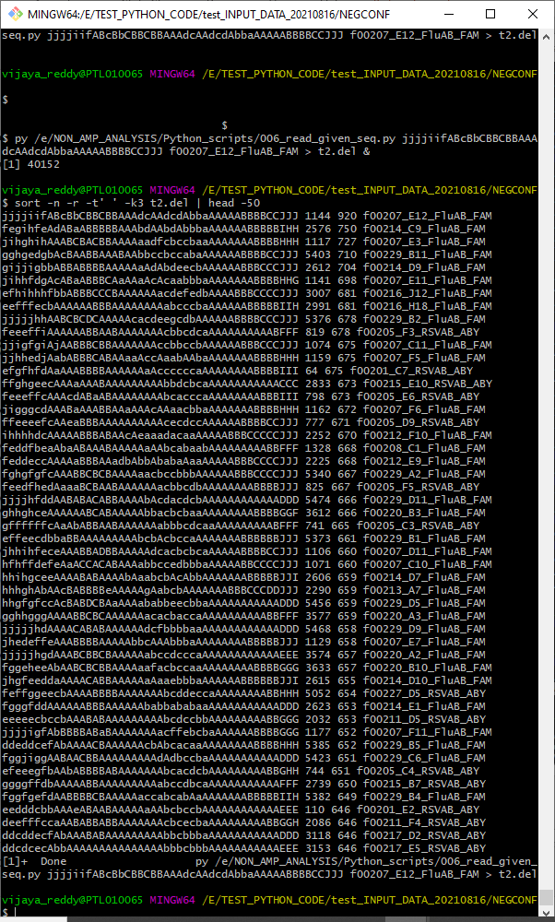
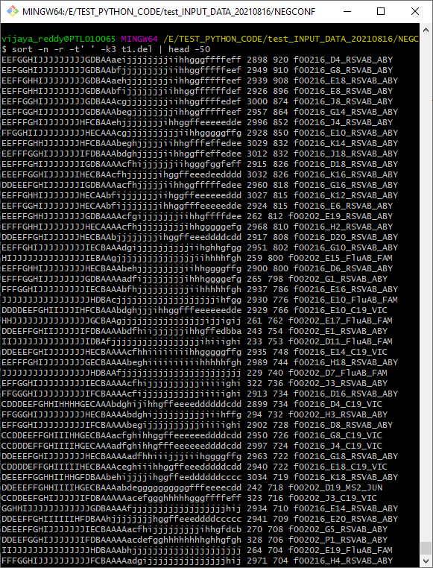
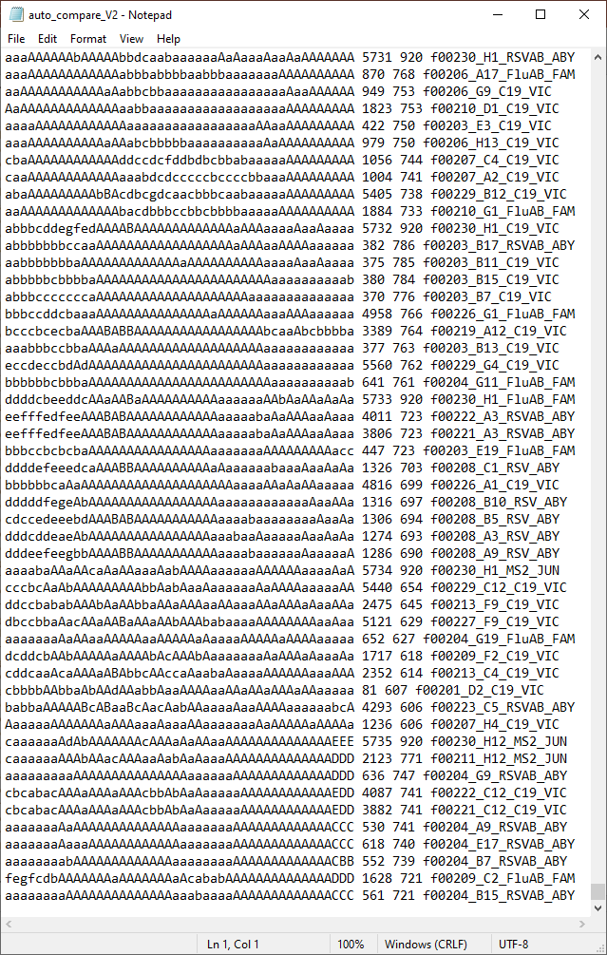
Scripting Modules
EDS-to-XLSX
Manual Export
CurveID dRn XLS-Sheets
Extract CurveID dRn to a CSV
Extreme-dRn value calculations
similarity weight matrix
Scoring similarity of curve patterns
Alfabet letter pattern assignment
Grouping of dRn Values at each cycle
All-to-all CuDB comparison
Search CuDB for similar curve(s)
Notes:
Started scripting using Python

Slide 6
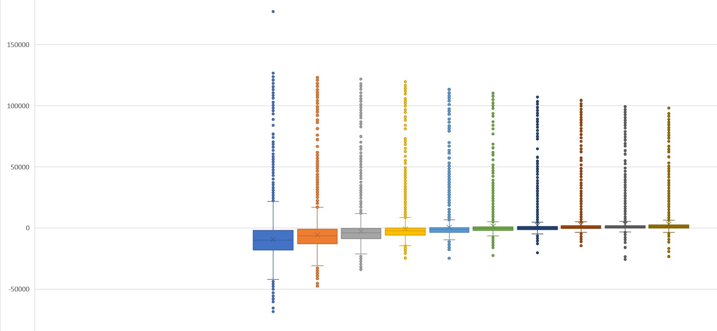
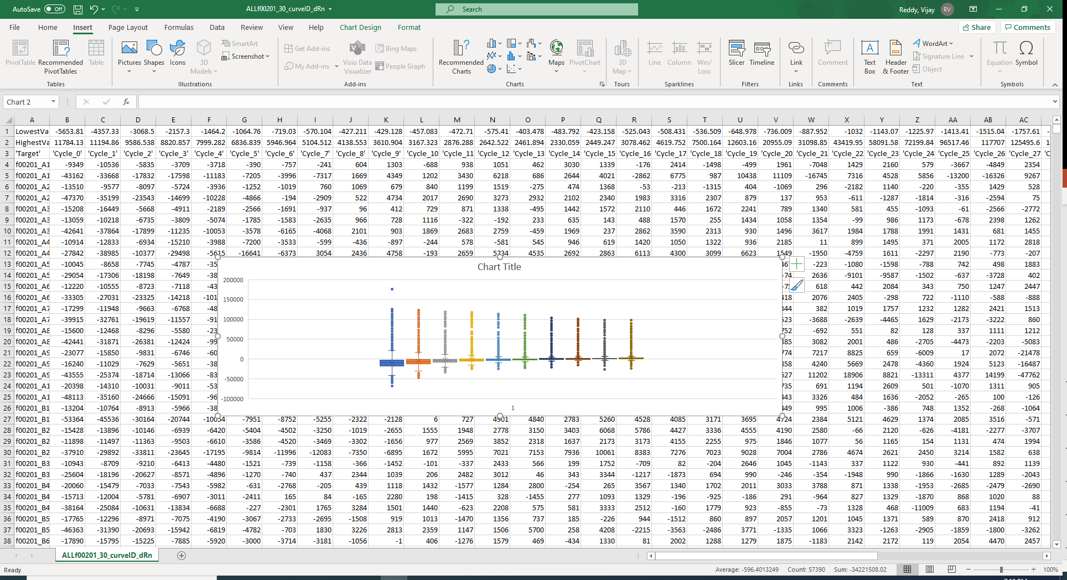
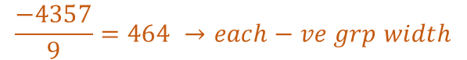
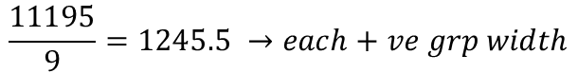
Extreme Value Calculation's and Grouping of dRn values
Distribution of dRn values in each of 10 Cycle
+ve Side Extreme Values
J
I
H
G
F
E
D
C
B
A
Mean
Top 10%
J
I
H
G
F
E
D
C
B
A
$$\frac{11195}{9}=1245.5 →each+ve grp width$$
a
b
c
d
e
f
g
h
i
j
a
b
c
d
e
f
g
h
i
j
Demo of Grouping Cycle-1
$$\frac{−4357}{9}=464 →each−ve grp width$$
Mean Bottom 10%
-ve Side Extreme Values

Slide 7
Scoring similarity of curve patterns
cbbbaAAAABBBBBBCBAAAaAabddffffffddcbaaAAAAAAAA f00230_F3_RSVAB_ABY
bcbcbabccaAAAAAAAaAabAbaAaAAaaaAAAaAAaaAaAaAaa f00201_F1_C19_VIC
18 18 18 -3 18 16 20 20 -5 -7
18 18 -4 18 18 18 -2 18 16 10
20 -2 -4 18 18 -2 18 -7 -7 10
54+36+10+33+54+32+36+31+4+13
= 842
+++
Maximum possible score= 920
bcbcbabccaAAAAAAAaAabAbaAaAAaaaAAAaAAaaAaAaAaa 138 920 f00201_F1_C19_VIC
cbbbaAAAABBBBBBCBAAAaAabddffffffddcbaaAAAAAAAA 5695 842 f00230_F3_RSVAB_ABY

Slide 8
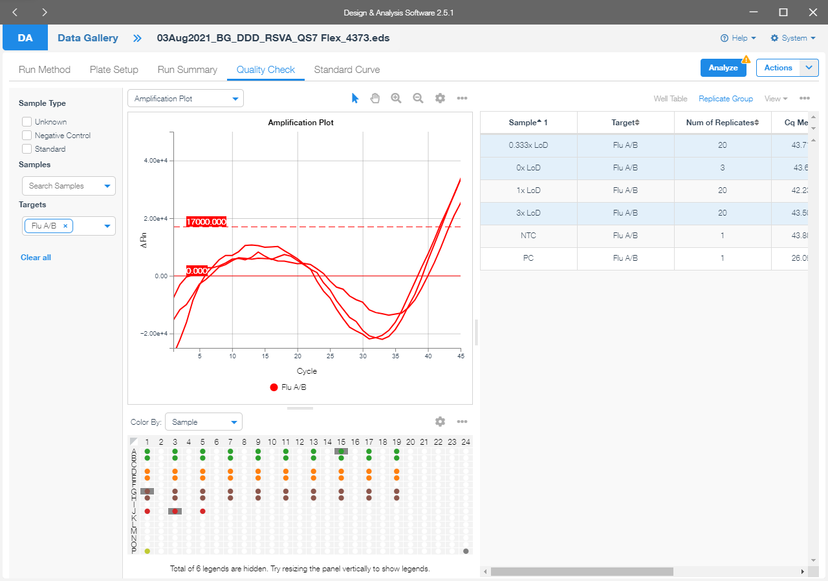
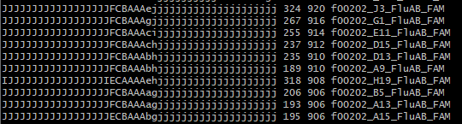
TESTS & RESULTS
Pattern-based identification of similar curves

Slide 9
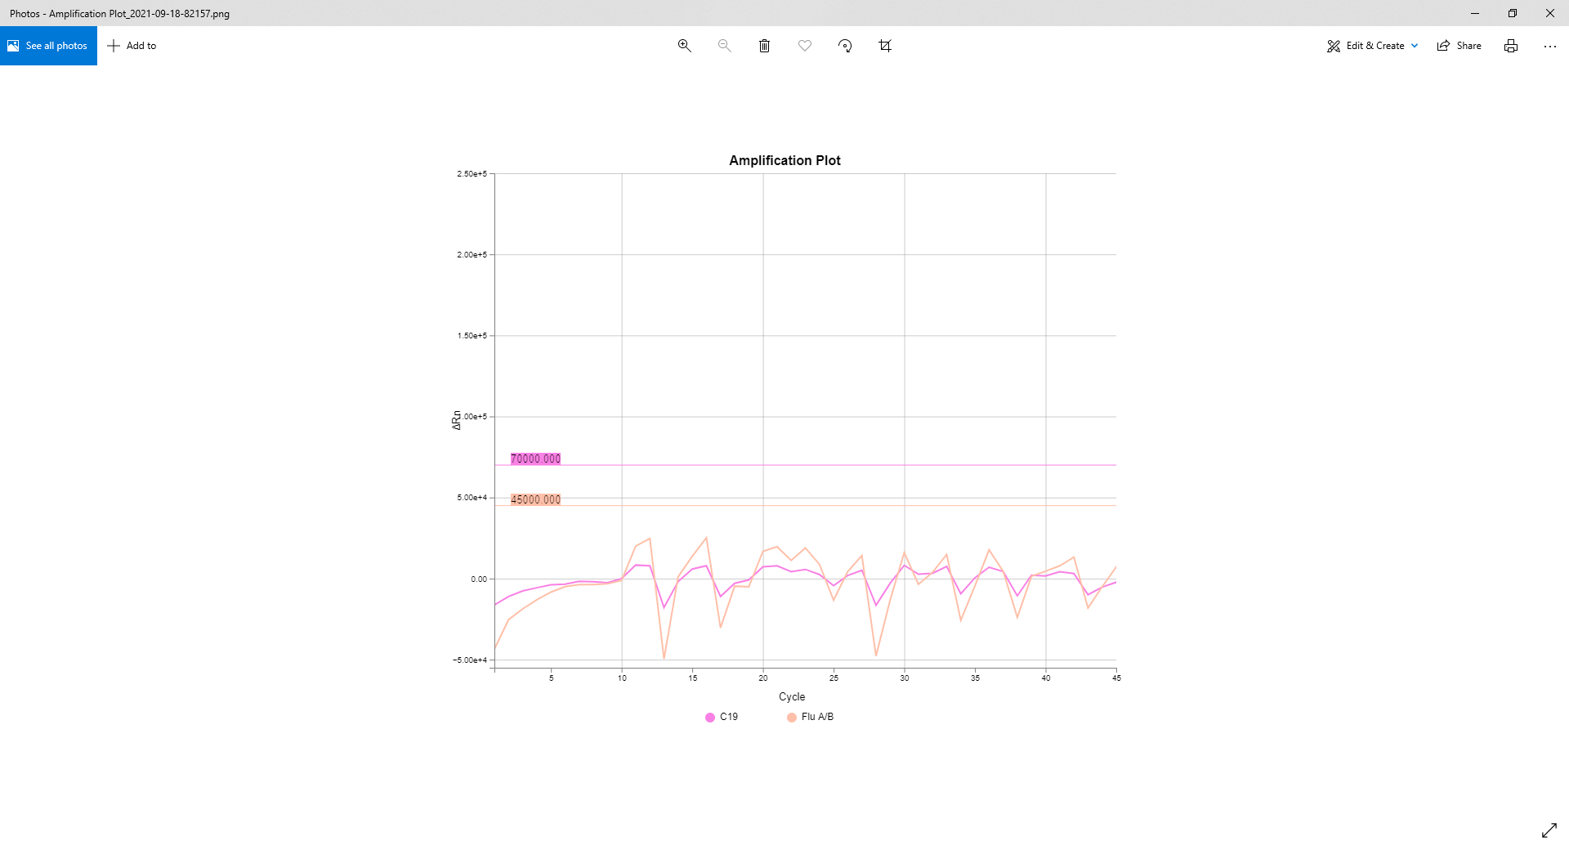
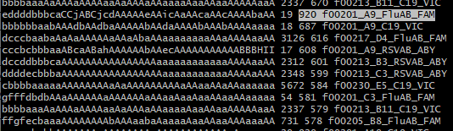
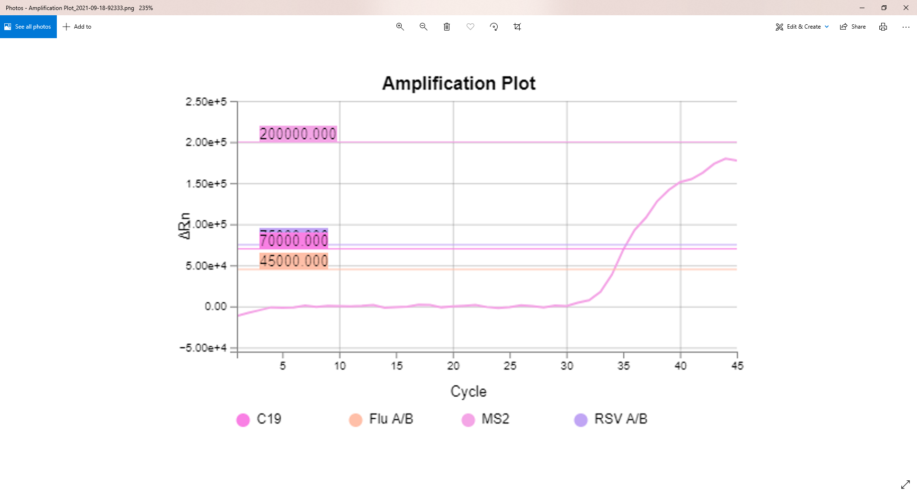
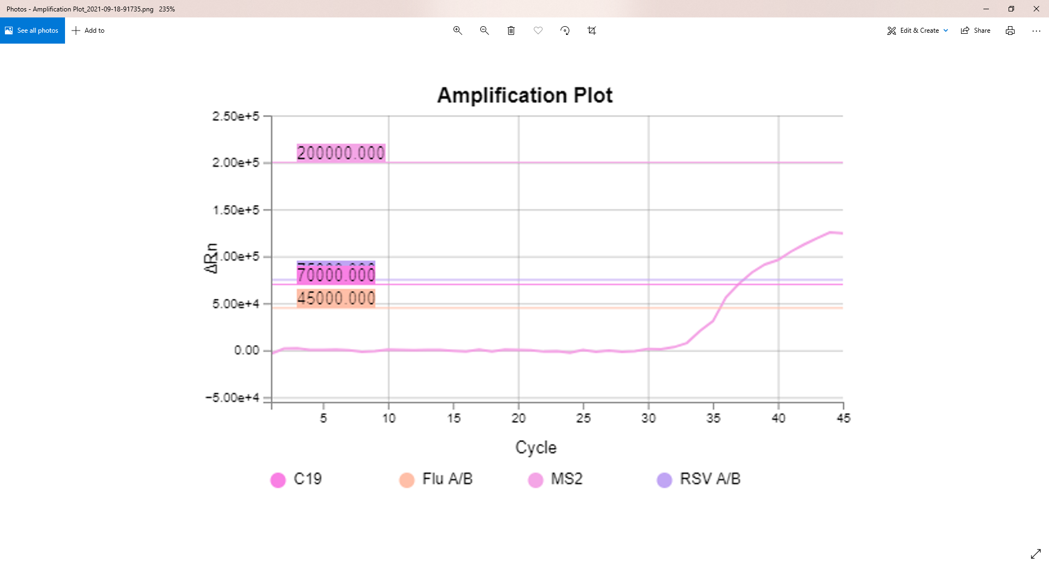
AaAaAAaaAAaAaAaaaAaAAAAAAAAABCEGIJJJJJJJJJJbaa 4815 920 f00225_H12_MS2_JUN
AAAaAaaaAaaaaaAAaaAaAAAAAAAAABCEGHHHHIIIIIIaaa 4441 654 f00223_H12_MS2_JUN
Pattern-based identification of similar curves

Slide 10
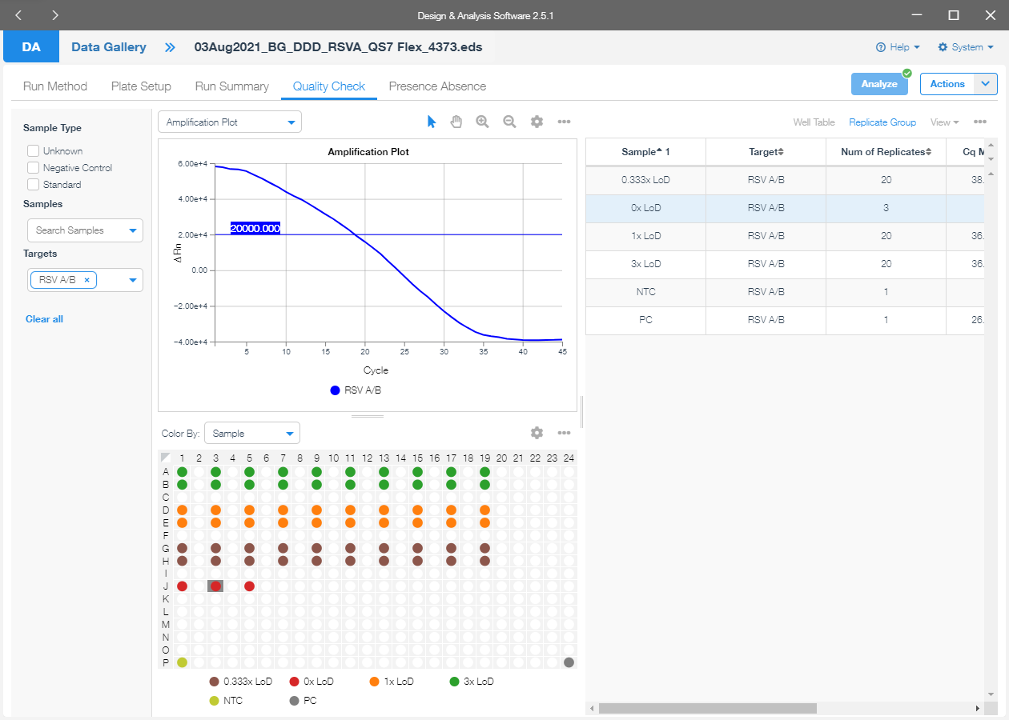
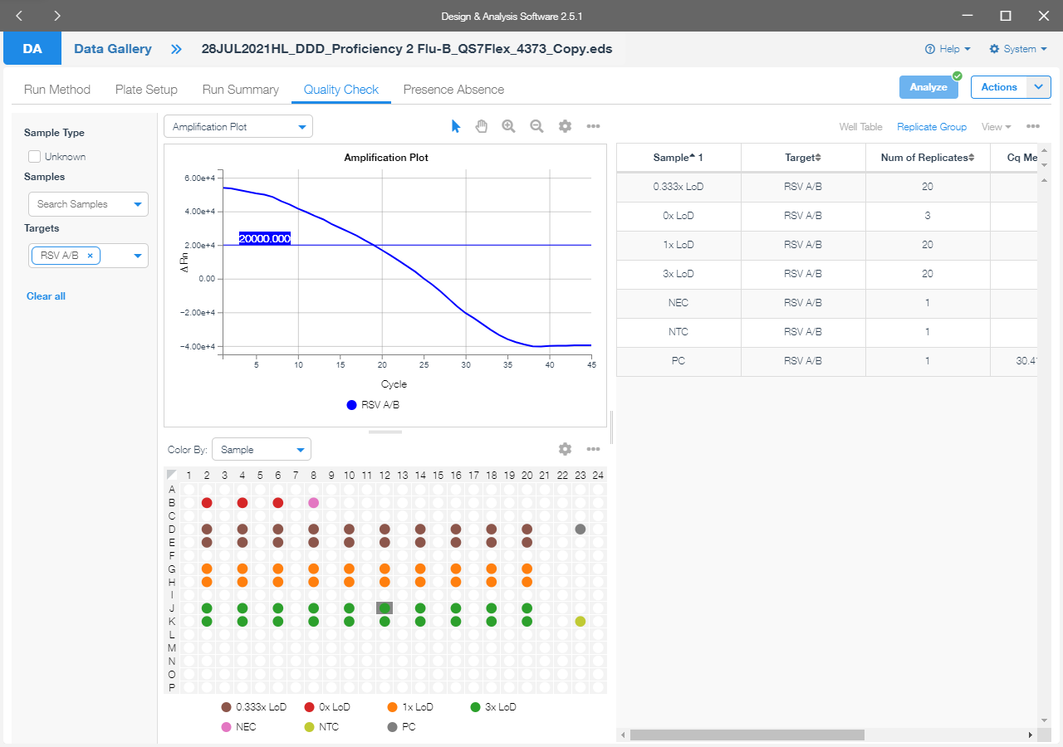
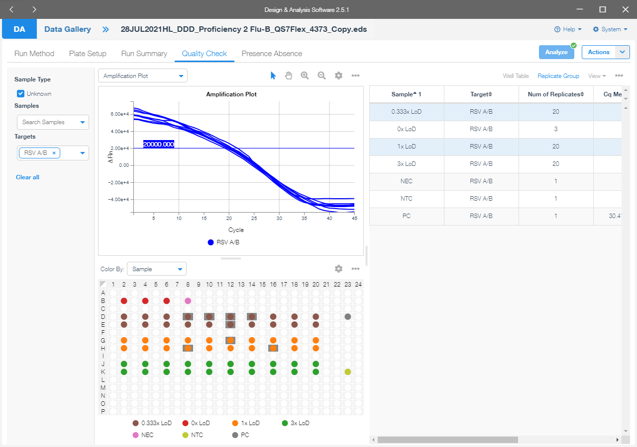
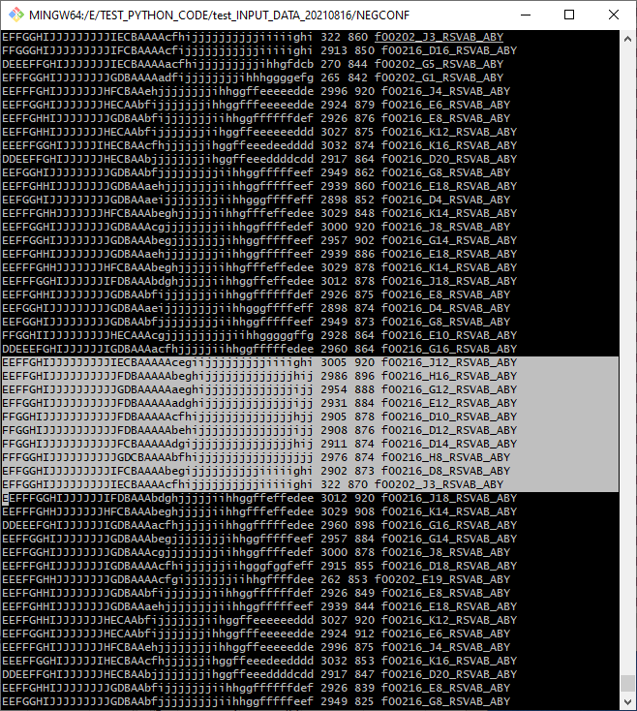
Pattern-based identification of similar curves

Slide 11
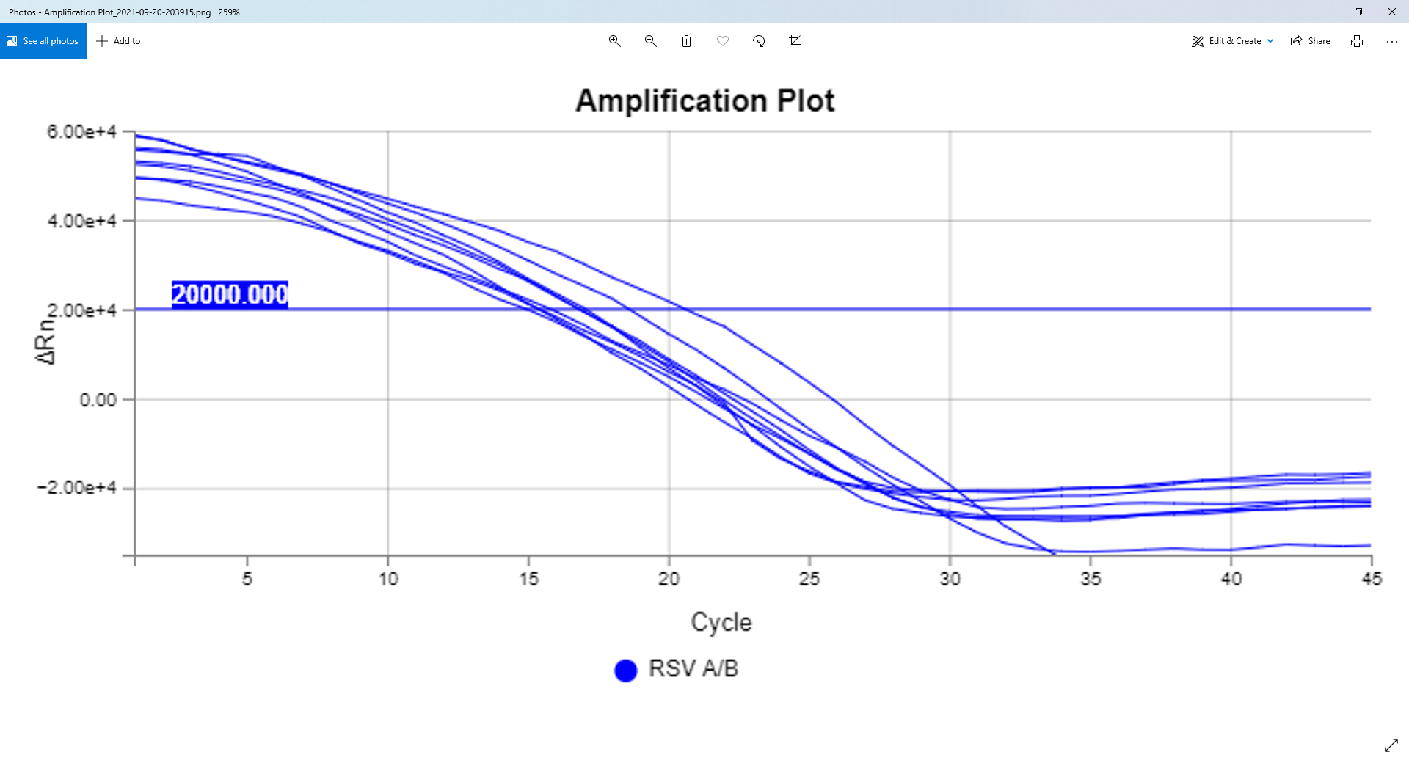
EEEFFGGHIJJJJJIHECBAAcfhjjjjjjihggffeeedeedddd 3032 920 f00216_K16_RSVAB_ABY
DDEEFFGHIJJJJJJHECBAAbjjjjjjjjihggffeeeddddcdd 2917 890 f00216_D20_RSVAB_ABY
EEFFFGHIJJJJJJJHFCBAAehjjjjjjjjihhggffeeeeedde 2996 874 f00216_J4_RSVAB_ABY
EEFFGHHIJJJJJJJHECAAbfijjjjjjjiihggffeeeeeeddd 3027 853 f00216_K12_RSVAB_ABY
EEFFGGHIJJJJJJJHECAAbfijjjjjjjihhggfffeeeeedde 2924 853 f00216_E6_RSVAB_ABY
EEFFGHHIJJJJJJJJGDBAAbfijjjjjjjiihhggffffffdef 2926 850 f00216_E8_RSVAB_ABY
EEFFGHHIJJJJJJJJGDBAAaehjjjjjjjjiihhggfffffeef 2939 838 f00216_E18_RSVAB_ABY
EEFGGHIJJJJJJJJJGDBAAbfjjjjjjjjjiihhggfffffeef 2949 832 f00216_G8_RSVAB_ABY
EEFFFGHHJJJJJJJHFCBAAAbeghjjjjjiihhgfffeffedee 3029 828 f00216_K14_RSVAB_ABY

Slide 12
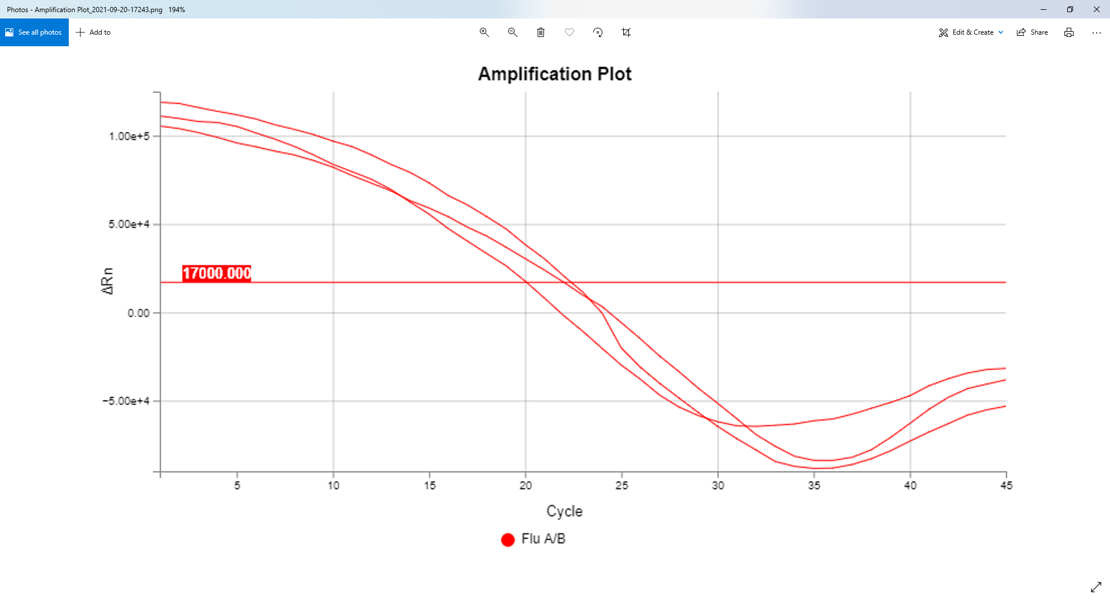
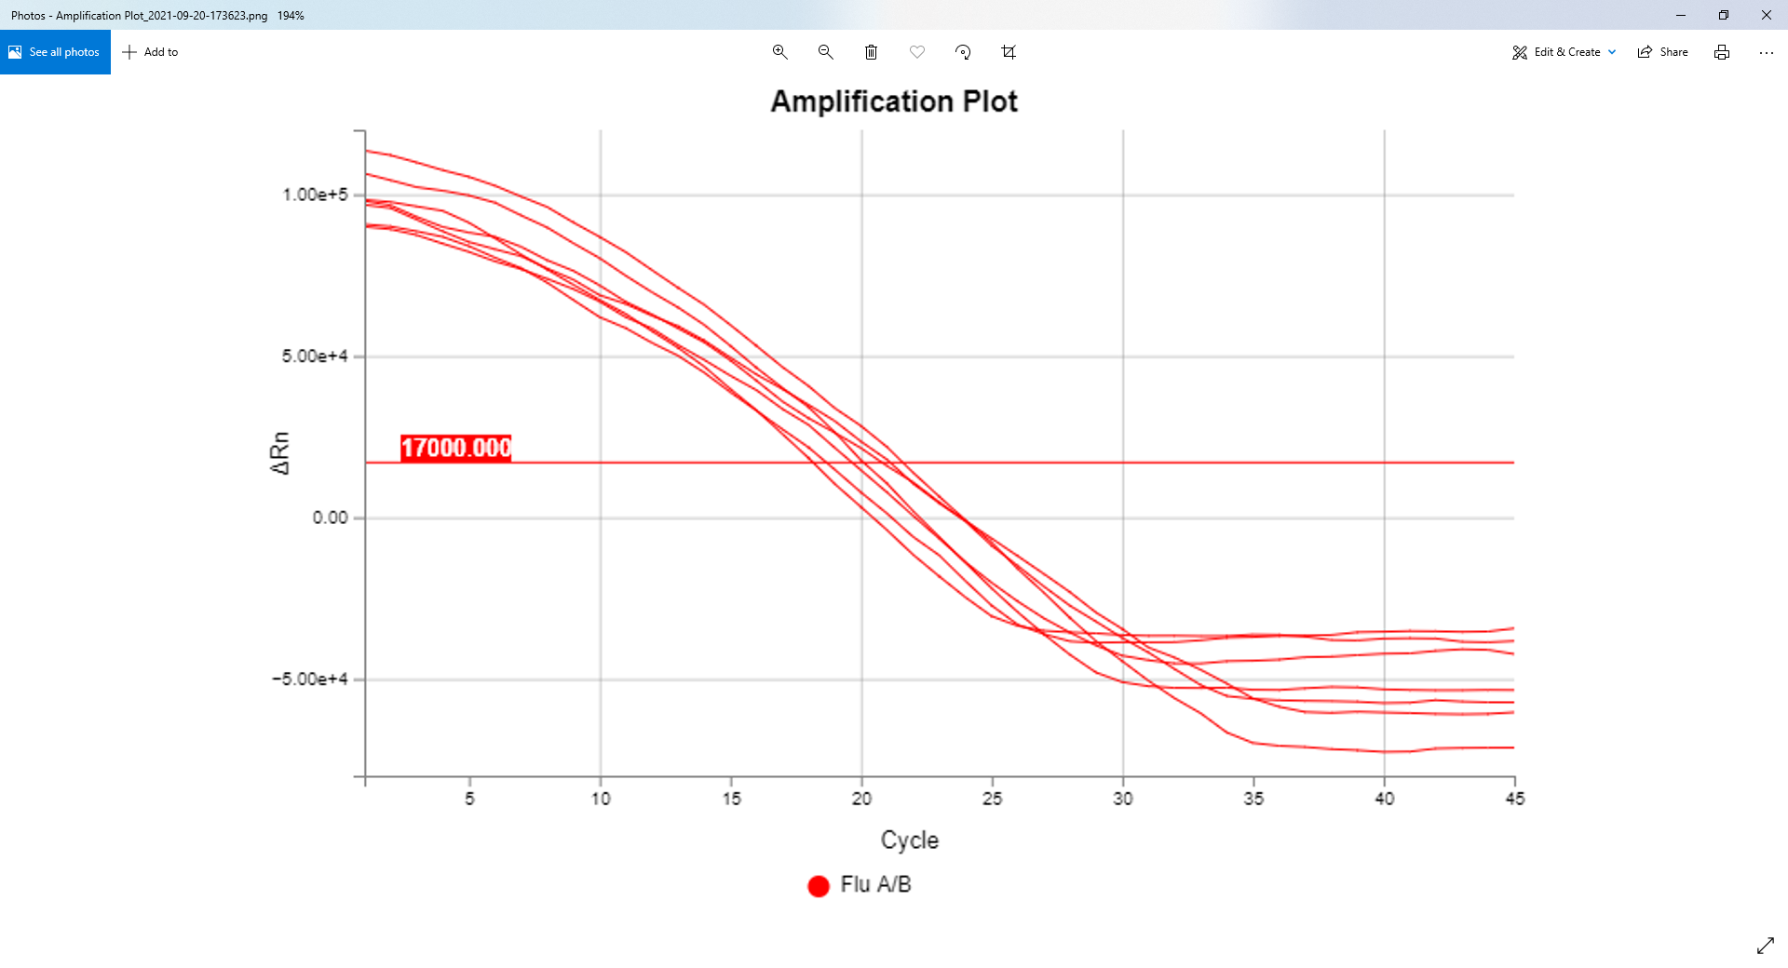
f00216_E10_FluAB_FAM
f00202_E15_FluAB_FAM
JJJJJJJJJJJJJJJJJHDBAcjjjjjjjjjjjjjjjjjjjihfgg 2930 920 f00216_E10_FluAB_FAM
HIJJJJJJJJJJJJJJIEBAAgjjjjjjjjjjjjjjjiihhhhfgh 259 876 f00202_E15_FluAB_FAM
JJJJJJJJJJJJJJJJJHDBAAfjjjjjjjjjjjjjjjjjjjjjjj 229 862 f00202_D7_FluAB_FAM
HHJJJJJJJJJJJJJJJGCBAAgjjjjjjjjjjjjjjjjijjigij 261 860 f00202_E17_FluAB_FAM
IIJJJJJJJJJJJJJJIDBAfjjjjjjjjjjjjjjjjjihiiighi 233 841 f00202_D11_FluAB_FAM
IIJJJJJJJJJJJJJJJHDBAAAbhjjjjjjjjjjjjjjjjjjjjj 264 815 f00202_E19_FluAB_FAM
JJJJJJJJJJJJJJJJJIECBAAagjjjjjjjjjjjjjjjjjjjjj 218 807 f00202_B17_FluAB_FAM
JJJJJJJJJJJJJJJJJJGDBAAajjjjjjjjjjjjjjjjjjjjjj 2936 805 f00216_E14_FluAB_FAM
IIJJJJJJJJJJJJJJJGDBAAAafijjjjjjjjjjjjjjjjjjjj 241 805 f00202_D19_FluAB_FAM
IJJJJJJJJJJJJJJJJJECBAAAejjjjjjjjjjjjjjjjjjghh 2910 800 f00216_D12_FluAB_FAM

Slide 13
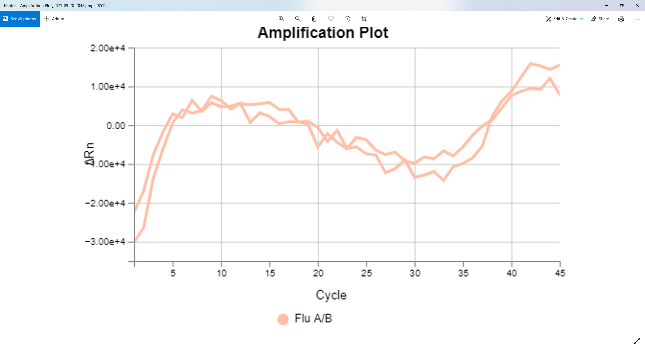
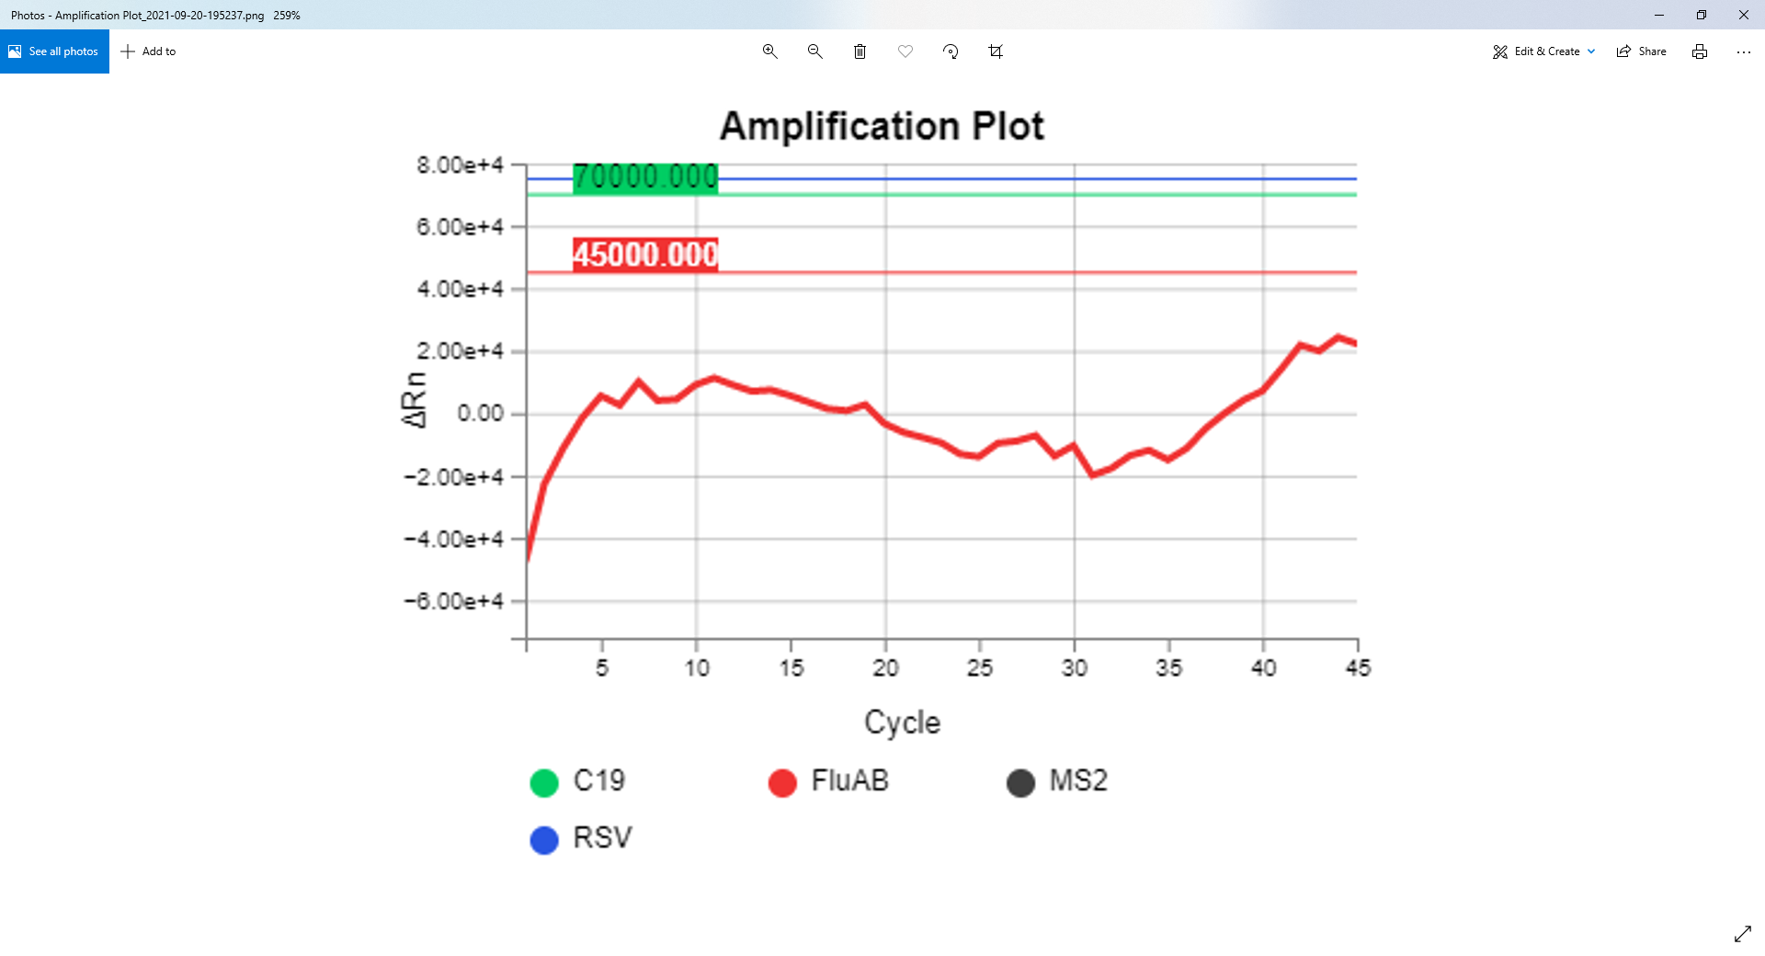
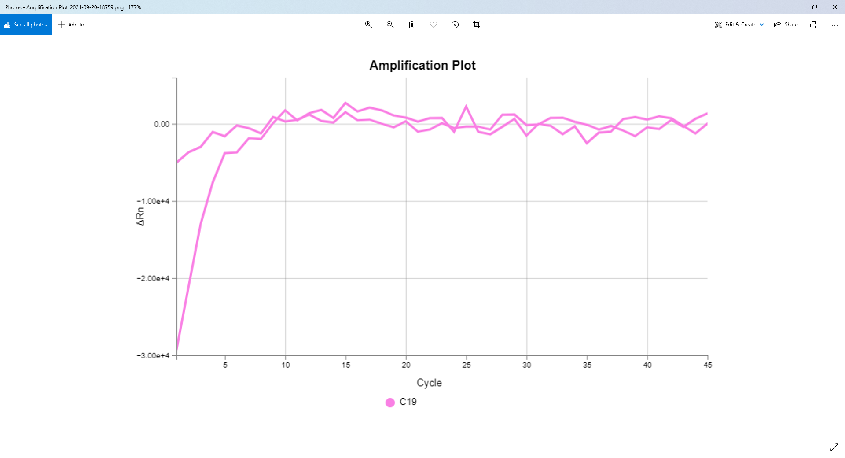
ifdaAABABCDDCDCBAAAfiijjjgfegehgededbaAAAAAAAA 1153 920 f00207_F3_FluAB_FAM
fgecAAAABBBBBCCBBAAafbfegfigeffeedccbAAAAAAAAA 2662 780 f00214_F2_FluAB_FAM
gedaAAABBBCBBBCAAAbecefggfhffefeddbaaAAAAAAAAA 1688 773 f00209_E2_FluAB_FAM
ecbbAABCBCBDCEBAAAbdhihgihijjjhhfedaaAAAAAAAAA 5522 773 f00229_F3_FluAB_FAM
ffgdAAaABECDCBCAAAAfdgjghgigghifdbcbAAAAAAAAAA 2404 764 f00213_D9_FluAB_FAM
edAAAABBBCBBCABAAAAfdhhhifffghedeccbaAAAAAAAAA 1703 763 f00209_E7_FluAB_FAM
eddaABBCCCDCEBEBAAhcihhjijjjjjjggecbAaAAAAAAAA 3702 762 f00220_D9_FluAB_FAM
eddcbAABBBBCCCDBBAAaAdcggdfhggggfddbaaAAAAAAAA 5489 759 f00229_E4_FluAB_FAM
gecbaAABBCCBCBBBAbAeejgfghhggffddcbaaAAAAAAAAA 2452 755 f00213_F1_FluAB_FAM
ddcaAABABBBBABAAAAAidefcdeedeeddccbaaAAAAAAAAA 2692 754 f00214_F12_FluAB_FAM
ccbbaaAAAABCBBBAbAgbgcedcAAAABDEGHIJJJJJJJJcbb
4483 920 f00224_B10_C19_VIC
abaAbaAAAABBBAAAbAcedacbAAAABCDFGHIJJJJJJJJaaa
4447 811 f00224_A4_C19_VIC

Slide 14
Clustering of curves based on their different % of similarity
1903 independent clusters, at 70% similarity including the 1126 unique member clusters appears to be good number of clusters for user cases.
Cluster | No Clusters
Members | 60% | 70% | 80% | 90%
1 | 146 | 1126 | 3220 | 5306
2 | 85 | 326 | 386 | 312
3 | 39 | 143 | 113 | 129
4 | 31 | 72 | 67 | 63
5 | 11 | 46 | 42 | 45
6 | 11 | 24 | 32 | 26
7 | 6 | 13 | 15 | 20
8 | 10 | 24 | 13 | 14
9 | 6 | 9 | 13 | 13
10 | 5 | 10 | 7 | 5
>10 | 73 | 110 | 97 | 68
Total Groups | 423 | 1903 | 4005 | 6003
Highest Member cluster | 2204 | 1185 | 531 | 136

Slide 15
Usefulness of Prototype and
Proposed Future Enhancements
Automated annotation of Amp and non-amp curves in every experiment.
Using experts’ knowledge and reasoning only once in lifetime until and unless next distinct curve is noticed/obtained.
Future automated study analysis report generation on the fly, (Improvements to present automated script)
Grouping and sub-grouping of present and future curve data
Knowledge-base creation for any type of Machine Learning algorithms to use in identifying difficult and problematic curves
Improving generation of comparative or bridging study reports between instruments, plates, dyes, LoDs, comparative curve geometry patterns can be reported.
Experts Knowledge and reasoning cab automatically placed in each study report based on classified curve geometry patterns
Pattern-based classification can be extended to identify multi curve interference, cross talks and contaminations that can possibly be reported automatically.
(Curve Database) cuDB interactive web site can be developed and made readily available for experimentalists to compare newly obtained curve(s) with previous experiments that gave similar curve(s).
Addition of instrument code (QS5, QS7,7500Fast etc.), and plat info (96 or 384 etc.) in curve-ID can be done, that helps to evaluate comparatively all these variables' interrelationships for future analytics purpose.

Slide 16
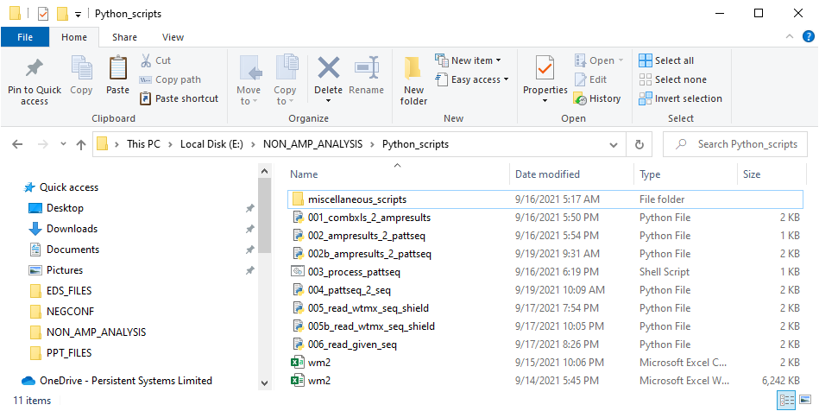
Code Demonstration to search for similar curves

Slide 17
GTS Analytics Team Lead by Sharada Vijaychander:
Onsite (US) : Suraj Pavaskar, Vijay Reddy, Xinyi Yan, Umair Khan, Gino Garcia
Off Site (India): Aniketan Swami, Ankita Gupta, Harikishan Ellamla, Ashwani Jha, Ashish Pathak, Bhagyashree Hote, Puneet Kadimi, Pradeep Phule
THANKS to you ALL
QUESTIONS ???
SUGGESTIONS AND COMMENTS

Slide 18
Scripting to quantify the curve-patterns
EDS to combined EXLS through export (manually)

Slide 19
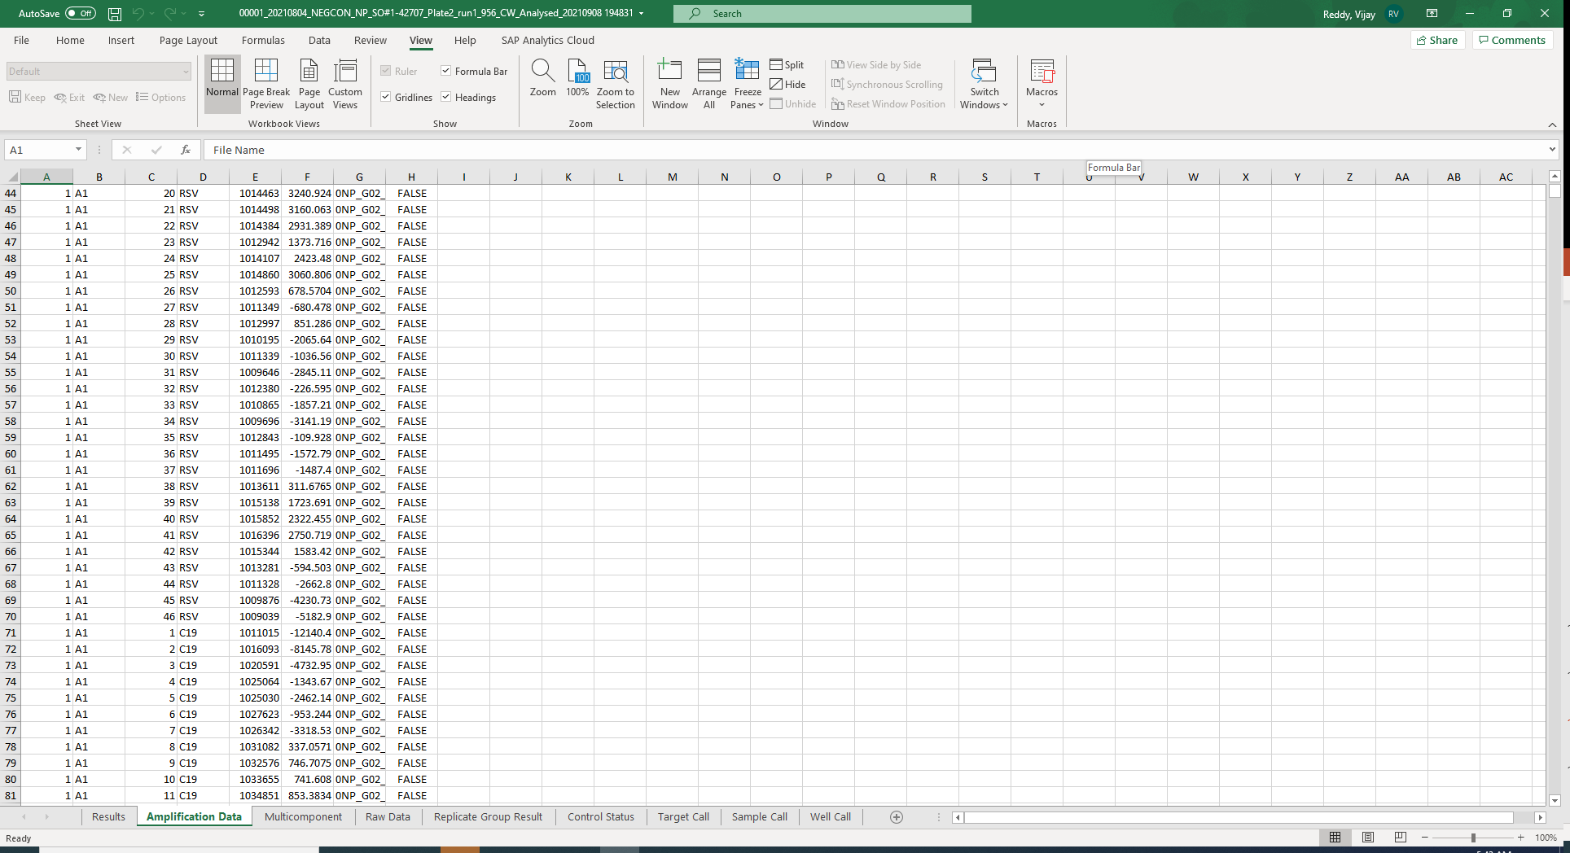
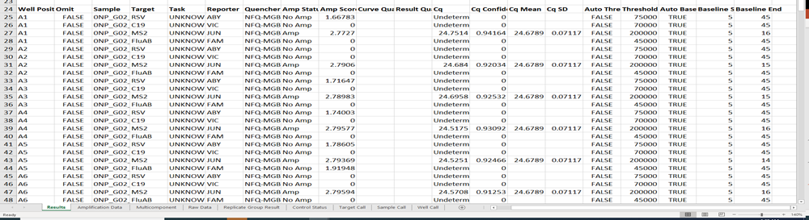

Information used from combined exls file
Scripts

Slide 20

Scripts

Slide 21

Scripts

Slide 22
Scripts

Slide 23

Scripts

Slide 24
Scripts

Slide 25
py /e/NON_AMP_ANALYSIS/Python_scripts/006_read_given_seq.py EEFGGHIJJJJJJJJJGDBAAaeijjjjjjjjiihhgggffffeff f00216_D4_RSVAB_ABY > t1.del &
Scripts

Slide 26
AaAaAAaaAAaAaAaaaAaAAAAAAAAABCEGIJJJJJJJJJJbaa 4815 920 f00225_H12_MS2_JUN
AAAaAaaaAaaaaaAAaaAaAAAAAAAAABCEGHHHHIIIIIIaaa 4441 654 f00223_H12_MS2_JUN
Pattern-based identification of similar curves

Slide 27
Similarity weight matrix developed and used for scoring and for identifying similar curves

